Slide 1
Security assessment of OWASP Juice Shop
Name : Aditya shekhar
Cybersecurity
Batch-2 June

Slide 2
Index
Introduction
Objective
Scope
Tools Used
Reconnaissance and Application Mapping
Nmap Overview
Scan Results
Findings
Authentication and Session Testing
Burp Suite Configuration
Login Request Interception
Input Validation Testing
Customer Feedback Interception
Observations
OWASP Top 10 Vulnerabilities Identified
Score Board
DOM XSS
Cross-Site Scripting (XSS)
Privacy Policy
Sensitive Data Exposure
Security Misconfiguration
Improper Input Validation
Unvalidated Redirects
Repetitive Registration
Findings and Analysis
Remediation Recommendations
Conclusion

Slide 3
Reconnaissance and application mapping
Reconnaissance and Application Mapping comprise the first step of security testing. You need to know which hosts are alive and what services are running on them before performing any vulnerability scanning or hardening your system
1. Core Phases of Nmap Reconnaissance
Reconnaissance typically follows a structured progression from broad discovery to granular service interrogation:
[ Active Host Discovery ] ---> [ Port Scanning ] ---> [ Service & OS Mapping ] ---> [ NSE Script Auditing ]

Slide 4
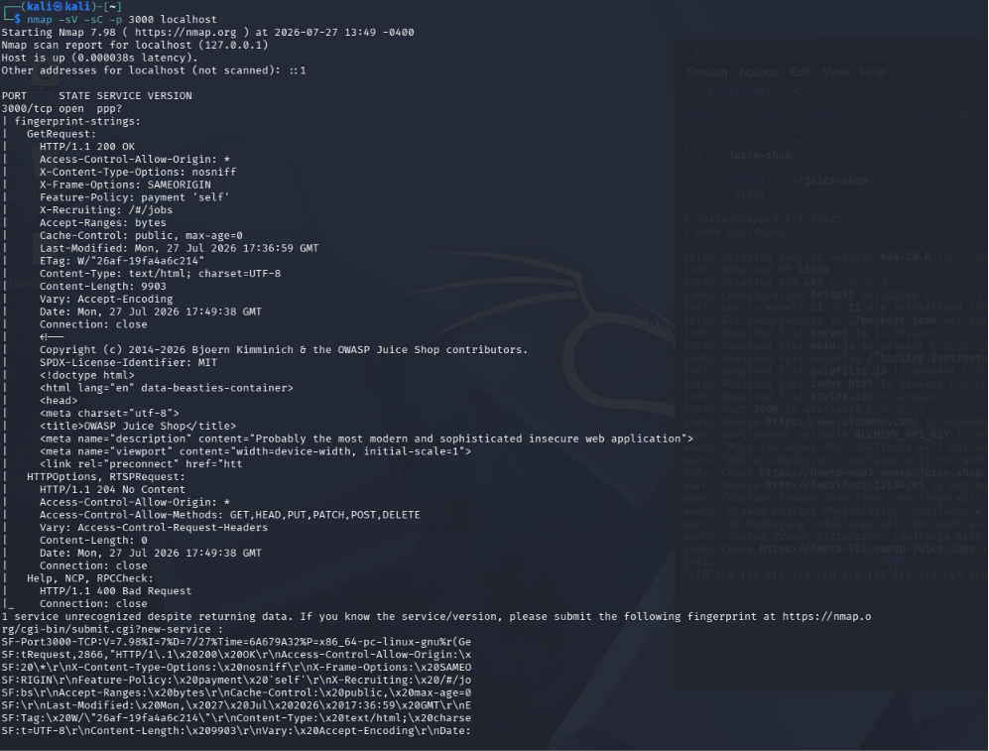
Reconnaissance and Application Mapping using Nmap (OWASP Juice Shop)
Command Used
nmap -sV -sC -p 3000 localhost
Interpretation
The target host is up.
TCP Port 3000 is open.
The application running on port 3000 is OWASP Juice Shop, a Node.js web application.
HTTP Information Discovered
Nmap retrieved several HTTP headers:
HTTP/1.1 200 OK
This indicates:
The web server is functioning correctly.
The requested page loaded successfully.

Slide 5
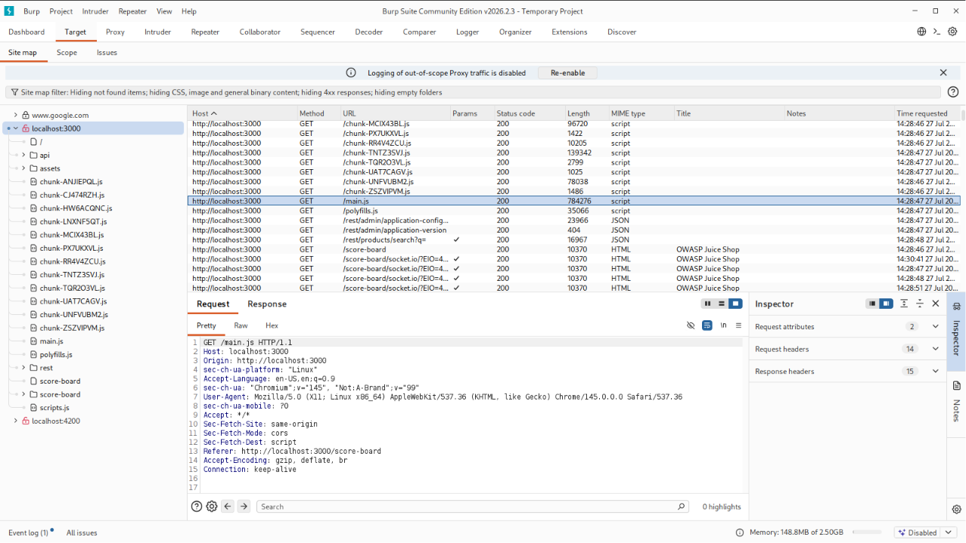
Information Gathered
Host is reachable.
Port 3000 is open.
HTTP service is running.
Application title identified as
OWASP Juice Shop.
Security headers detected:
X-Frame-Options
X-Content-Type-Options
Access-Control-Allow-Origin
HTML page successfully retrieved.
Default NSE scripts executed successfully.
Reconnaissance Findings
Target: localhost (127.0.0.1)
Application: OWASP Juice Shop
Listening Port: 3000/TCP
Protocol: HTTP
Status: Running and accessible
Technology: Node.js web application (inferred from Juice Shop deployment)
Purpose: Intentionally vulnerable application for security training

Slide 6
Conclusion
The Nmap reconnaissance successfully identified a live web application running on TCP port 3000. Version detection and default NSE scripts confirmed that the service responds over HTTP and exposed useful information such as HTTP headers, the page title, and application metadata. This reconnaissance phase provides a clear application map and forms the basis for subsequent security assessment and vulnerability testing of the OWASP Juice Shop instance.

Slide 7
Authentication and session /Input validation testing
Authentication and Session Testing and Input Validation Testing are among the crucial elements in testing for the security of web applications. The objective of these tests is to make sure that the authentication process, session protection, and user input validation can be achieved. You need to conduct these tests only in your system or systems with your explicit permission.
1. Authentication and Session Testing Using Burp Suite
Objective
Verify that the application's login, logout, and session management mechanisms are secure.
Tools Required
Burp Suite Community/Professional
Browser (Firefox/Chrome)
Target application (e.g., OWASP Juice Shop)
Step-by-Step Procedure
Step 1: Configure Burp Suite
Open Burp Suite.
Go to Proxy → Intercept.
Turn Intercept ON.
Configure your browser to use Burp as a proxy (127.0.0.1:8080).

Slide 8
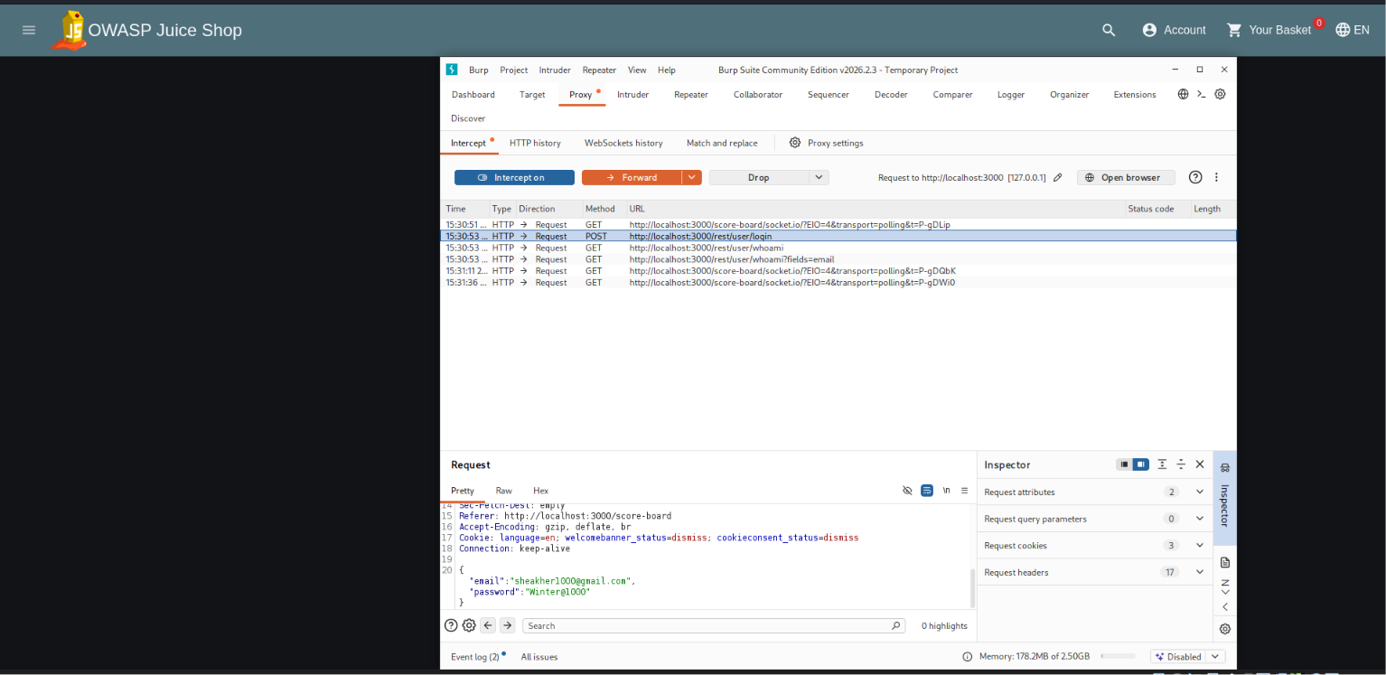
Capture Login Request
Open the application.
Enter username and password.
Click Login.
Burp intercepts the request.
email=sheakher1000@gmail.com
password=Winter@1000

Slide 9
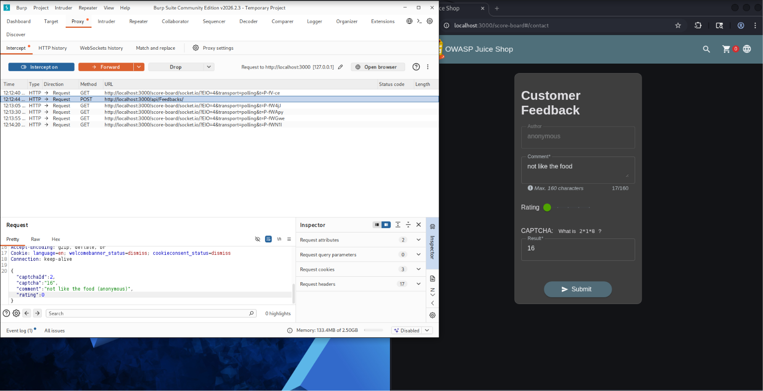
Intercepted the customer feedback post request
Enter the following details:
Author: anonymous
Comment: not like the food
Rating: 0 stars
CAPTCHA: 16
Click Submit.
Burp Suite intercepts the POST request before it reaches the server.
Analyze or modify the request, then click Forward to send it to the application.
{
"captchaId": 2,
"captcha": "16",
"comment": "not like the food (anonymous)",
"rating": 0
}

Slide 10
Observation
Burp Suite successfully intercepted the feedback submission request.
The request uses the HTTP POST method.
The feedback data is transmitted in JSON format.
The request can be inspected and modified before being forwarded to the server.
This helps verify whether the application performs proper server-side input validation.
Security Testing Purpose
Intercept HTTP requests
Analyze request headers and body
Test server-side input validation
Verify parameter handling
Understand client-server communication
Result
Customer Feedback Request was successfully intercepted through the use of Burp Suite. The HTTP POST request with feedback details was captured, highlighting the use of Burp Suite to analyze web application traffic and validate user input.

Slide 11
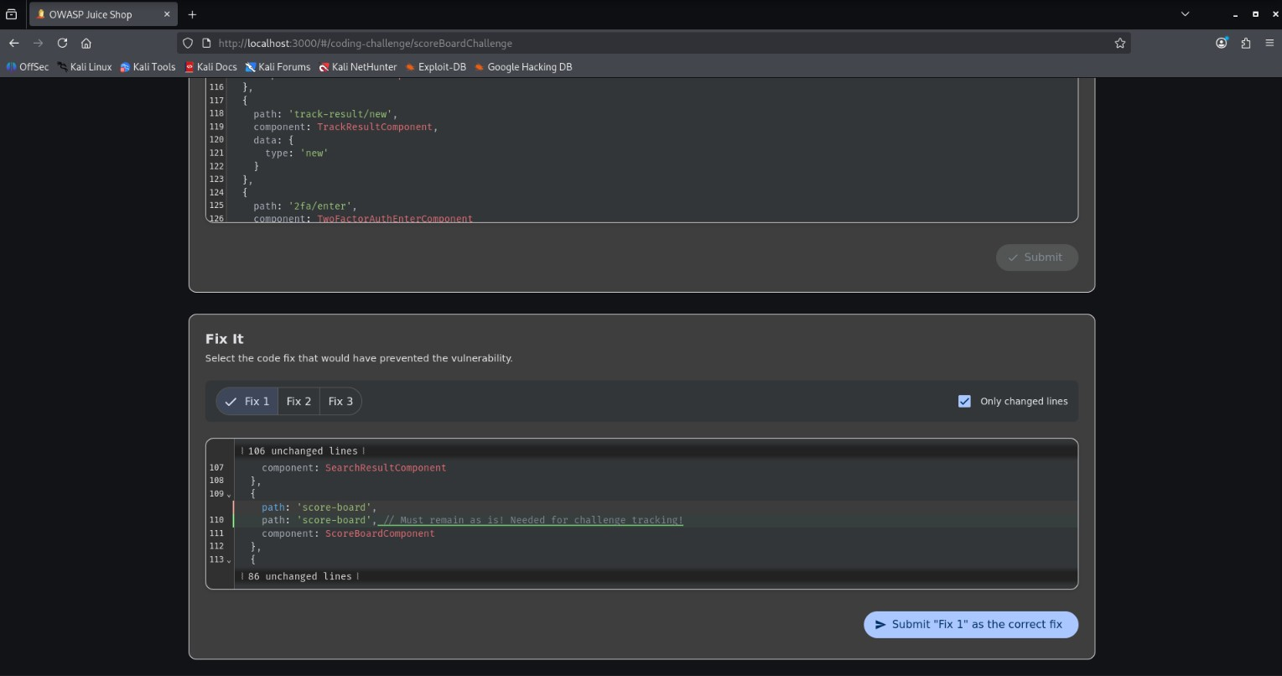
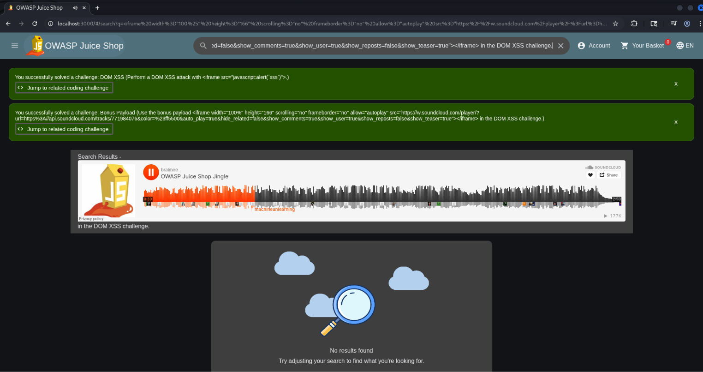
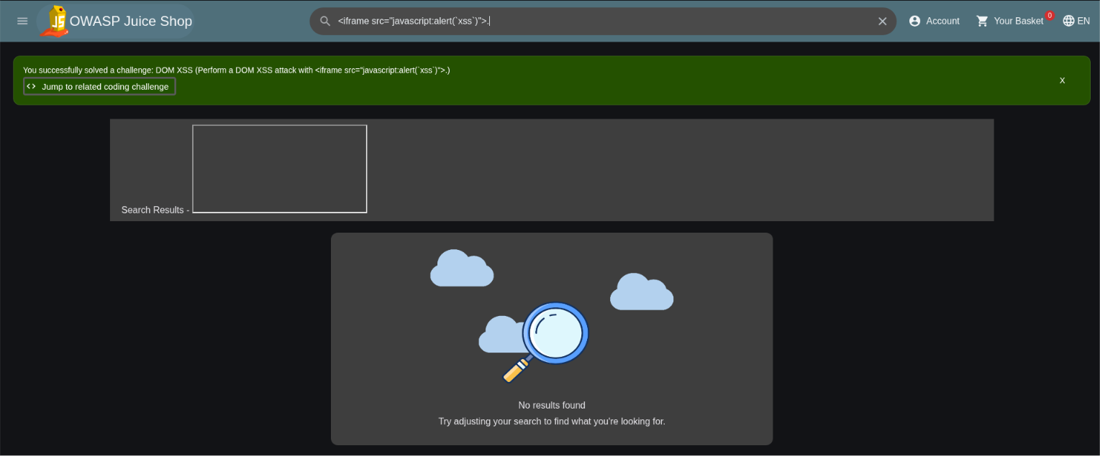
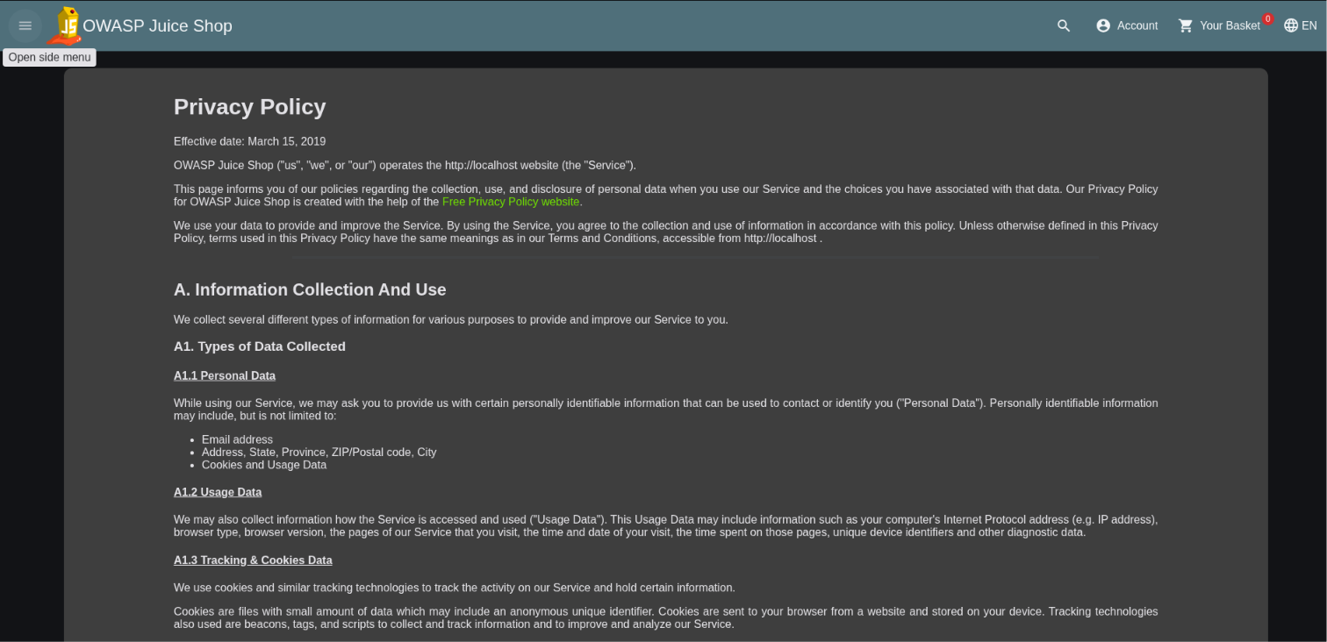
OWASP Ten Vulnerabilities
1 .Score Board
Find the carefully hidden 'Score Board' page.
2.DOM XSS
Perform a DOM XSS attack with <iframe src="javascript:alert(`xss`)">.
3.XSS
Use the bonus payload <iframe width="100%" height="166" scrolling="no" frameborder="no" allow="autoplay" src="https://w.soundcloud.com/player/?url=https%3A//api.soundcloud.com/tracks/771984076&co
4.Privacy Policy
Read our privacy policy.

Slide 12
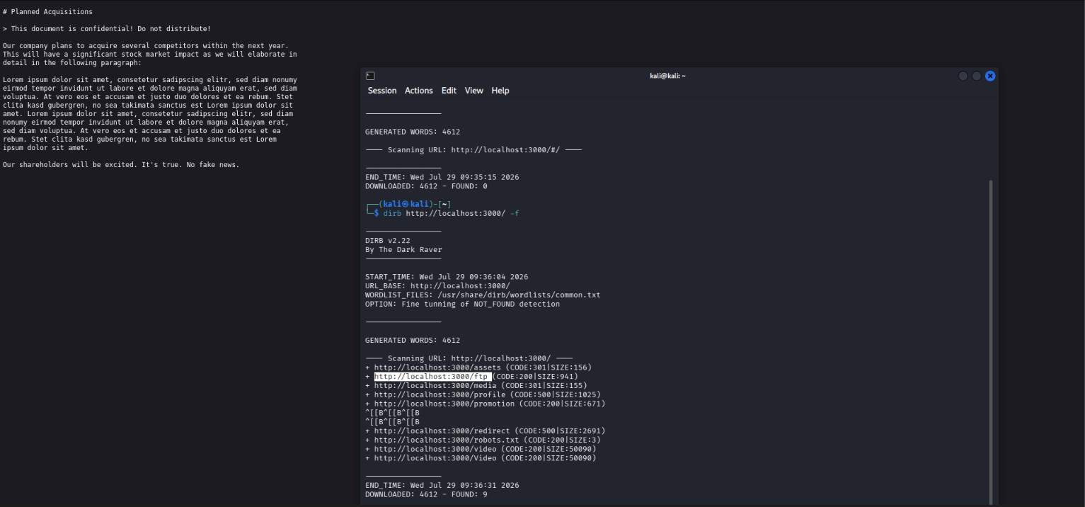
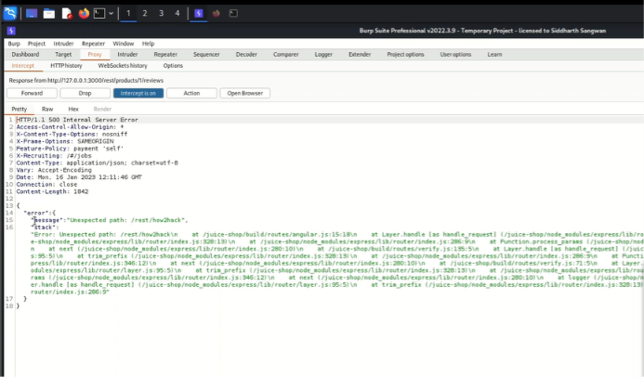
5.Sensitive Data Exposure
Confidential Document
Access a confidential document.
6. Security Misconfiguration
Error Handling
Provoke an error that is neither very gracefully nor consistently handled.
7. Improper Input Validation
Zero Stars
Give a devastating zero-star feedback to the store.

Slide 13
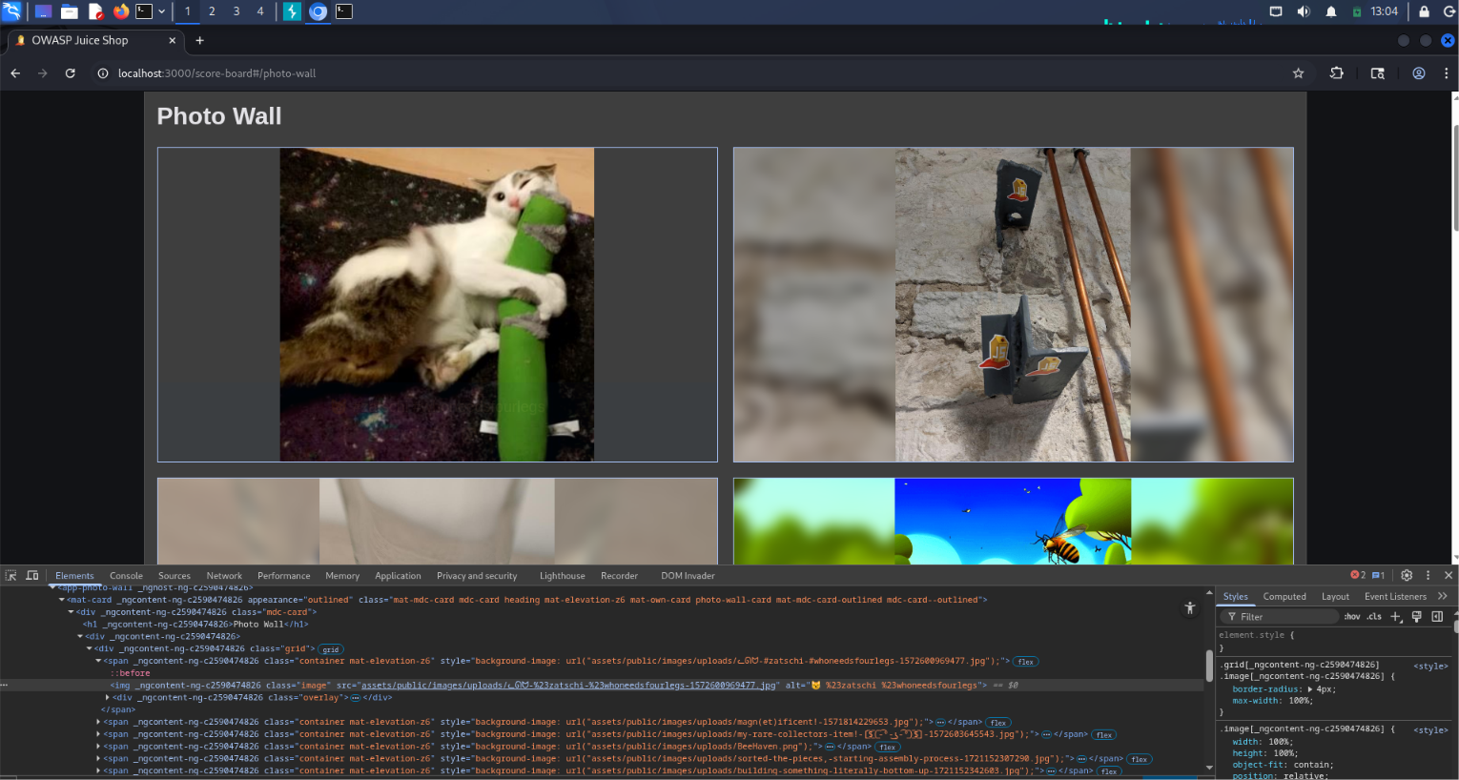
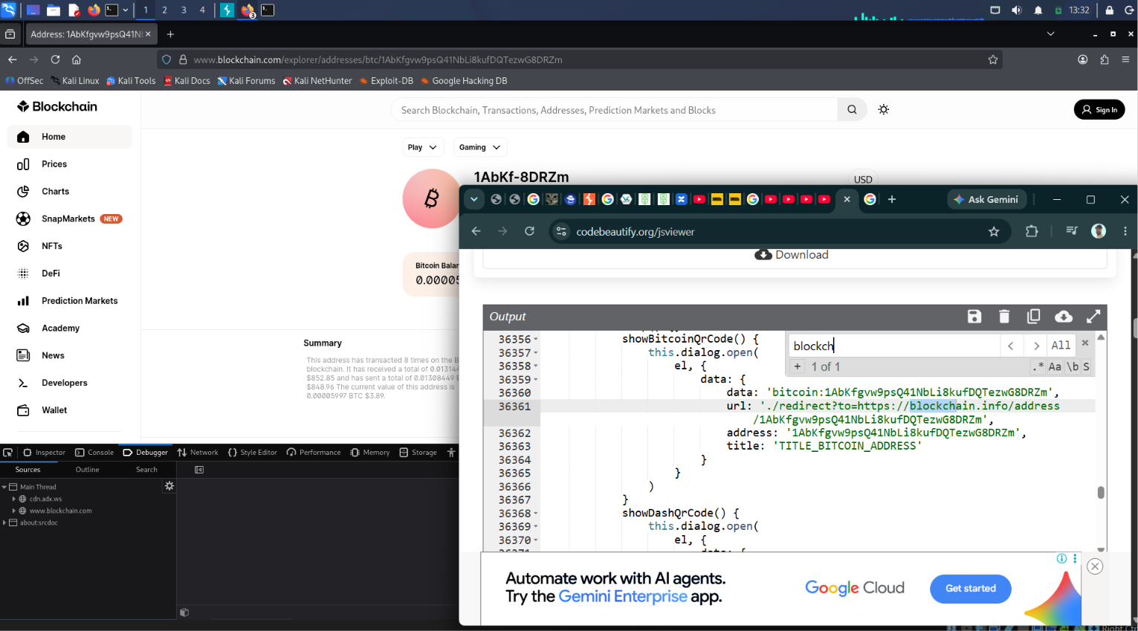
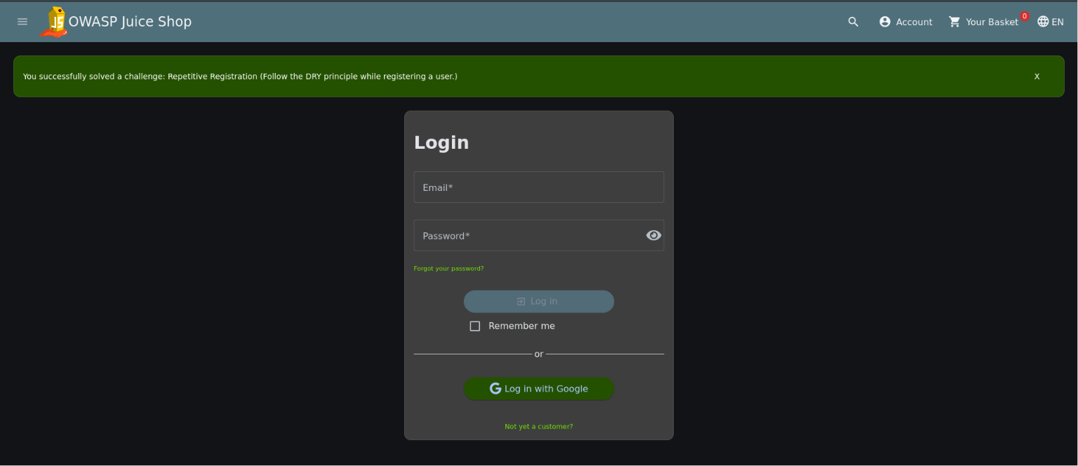
8.Improper Input Validation
Missing Encoding
Retrieve the photo of Bjoern's cat in "melee combat-mode".
9. Unvalidated Redirects
Outdated Allowlist
Let us redirect you to one of our crypto currency addresses which are not promoted any longer.
10. Improper Input Validation
Repetitive Registration
Follow the DRY principle while registering a user.

Slide 14
Conclusion
The security audit of OWASP Juice Shop helped in the identification and analysis of several typical web application security vulnerabilities. The systematic testing of the application using reconnaissance, application mapping, authentication and session testing, input validation testing, and vulnerability assessment, was aided by tools such as Kali Linux, Burp Suite, OWASP ZAP, and Nmap.
The assessment recognized multiple vulnerabilities that coincide with the OWASP Top 10. They included broken authentication, lack of input validation, broken session management, and several other web security concerns, which the application developers purposely added. For every problem that was recognized, the potential impact and method of exploitation and the risk associated with it were studied.
For each recognized vulnerability, a proposed solution was offered. This included coding the application in a secure manner and validating and sanitizing the user inputs, as well as strengthening the authentication and session management, applying the principle of least privilege, and frequent security testing during all phases of the software development lifecycle.
Overall, the project both illustrates and encapsulates the benefits which the security testing of an application, before it is deployed, provides. It offers a wealth of knowledge and experience that can be the basis for the testing of other applications and for the implementation of security measures

